Slide 1
Food borne disease outbreak (1998-2015)

Slide 2
Agenda
Problem statement
Executive summary
Global Outbreak map
Outbreak forecast
Fatalities rate
Monthly analysis
Containment zone analysis
Conclusion and next steps

Slide 3
Problem statement
Which specific country suffer from food borne disease every year?
Which state is considered to have most number of containment outbreaks count?
Which particular month and containment zone, a person must take precautionary measures at most?
Data source-
https://www.kaggle.com/cdc/foodborne-diseases

Slide 4
Executive summary
Restaurants in California, united states have the highest vulnerability for food borne disease according to frequency for visits in month of July
2017,2018 will likely to have a downward fall in count of outbreaks in united states.

Slide 5
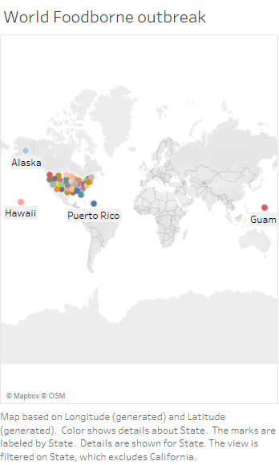
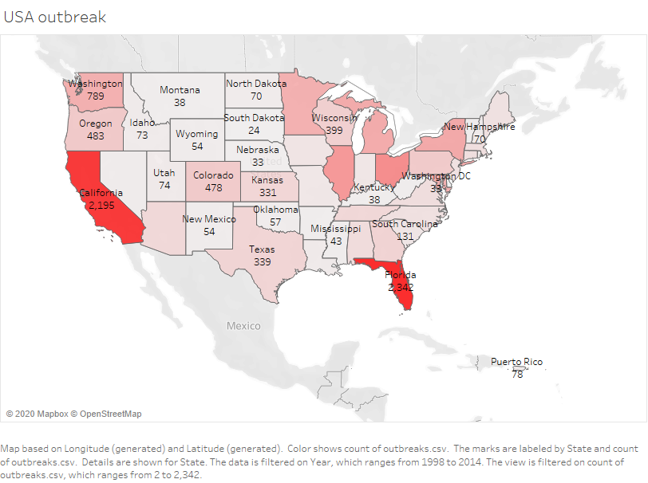
Global outbreak map
California and Florida have most count of outbreaks

Slide 6
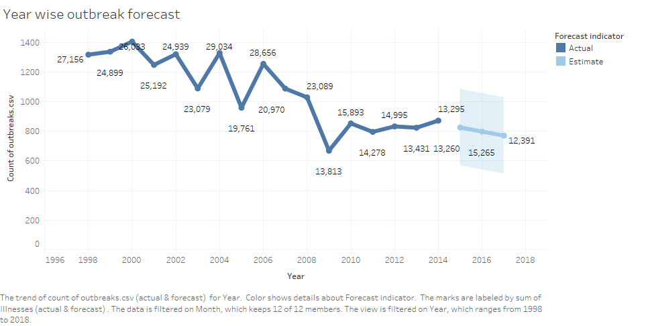
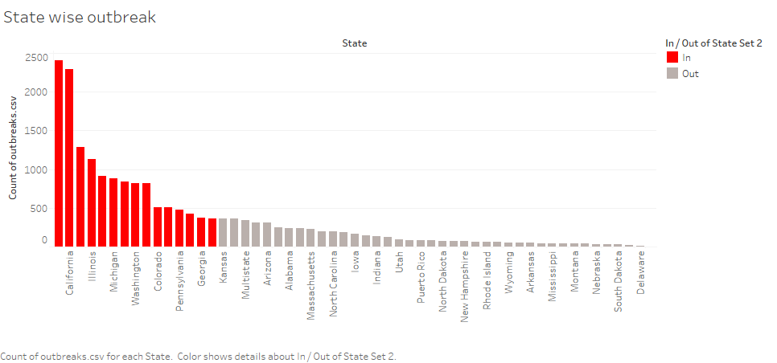
Outbreak forecast
Top 15 states outbreak

Slide 7
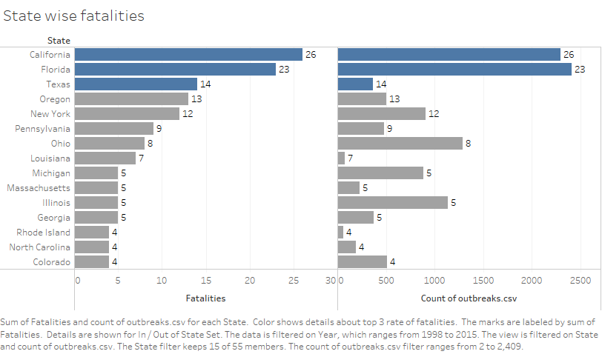
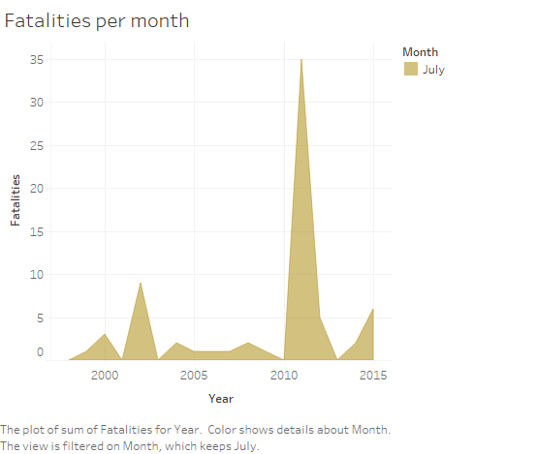
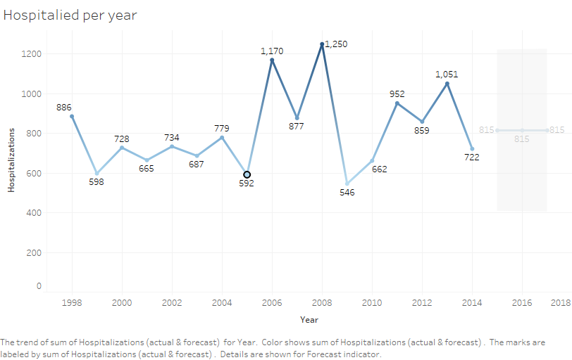
Fatalities rate
fatalities
hospitalized
illness
forecasting

Slide 8
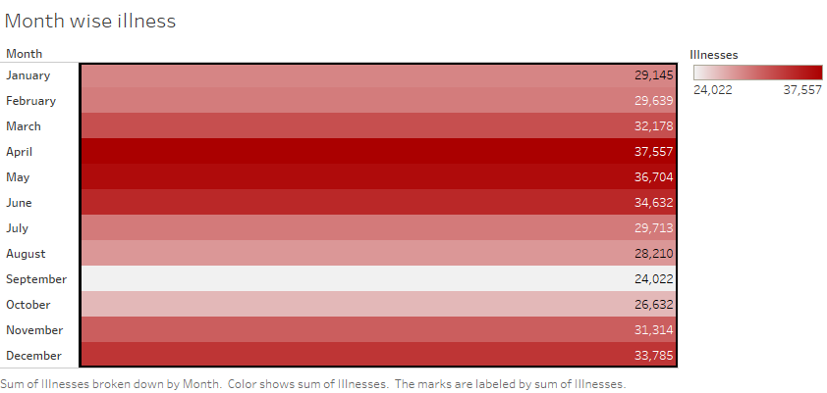
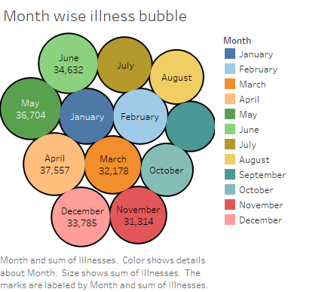
Monthly analysis
April, May, June, July are highly vulnerable months

Slide 9
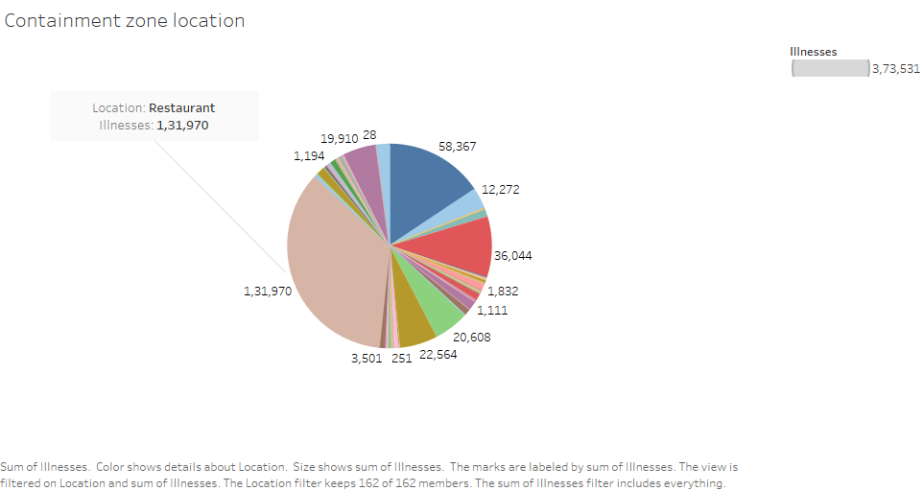
Containment zone analysis
Restaurants are the most containment zones prone to food borne disease

Slide 10
Conclusion and next steps
country
USA
state
CALIFORNIA
month
-JULY
zone
RESTAURANT
conclusion
Data source
ingredient
status
food
Next steps

Slide 11
QnA

